Slide 1
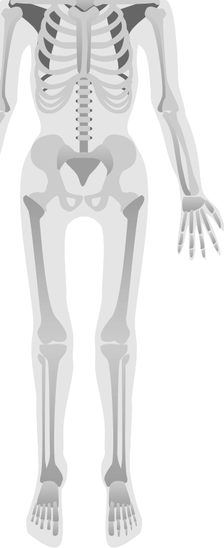

Medical Imaging Pipeline for 2D–3D Registration and Bone Shape Analysis
Sofía Loredo Hernández
08/11/2025

Slide 2
Table of contents
01
04
07
02
05
08
03
06
09
Introduction & Overall Goal
Data Preprocessing & Conversion
Post-processing Segmentation
Literature Review & Initial Exploration
DRR Generation & 2D–3D Registration
Shape Statistical Model (SSM) – Attempt 1
Dataset Search & Selection
Automatic 3D Segmentation
Shape Statistical Model (SSM) – Custom Implementation

Slide 3
Introduction & Overall Goal
01
-Ambitious goal: register 2D X-rays to 3D models, reconstruct missing parts, and obtain anatomical landmark positions.
-Approach: since this internship is only for 3 months, we focus on adapting the tools which will be of help to future interns. Such as DRR generation, automatic segmentation, and a custom PCA for SSM(Statistical Shape Model).

Slide 4
02
Literature Review & Initial Exploration

Slide 5









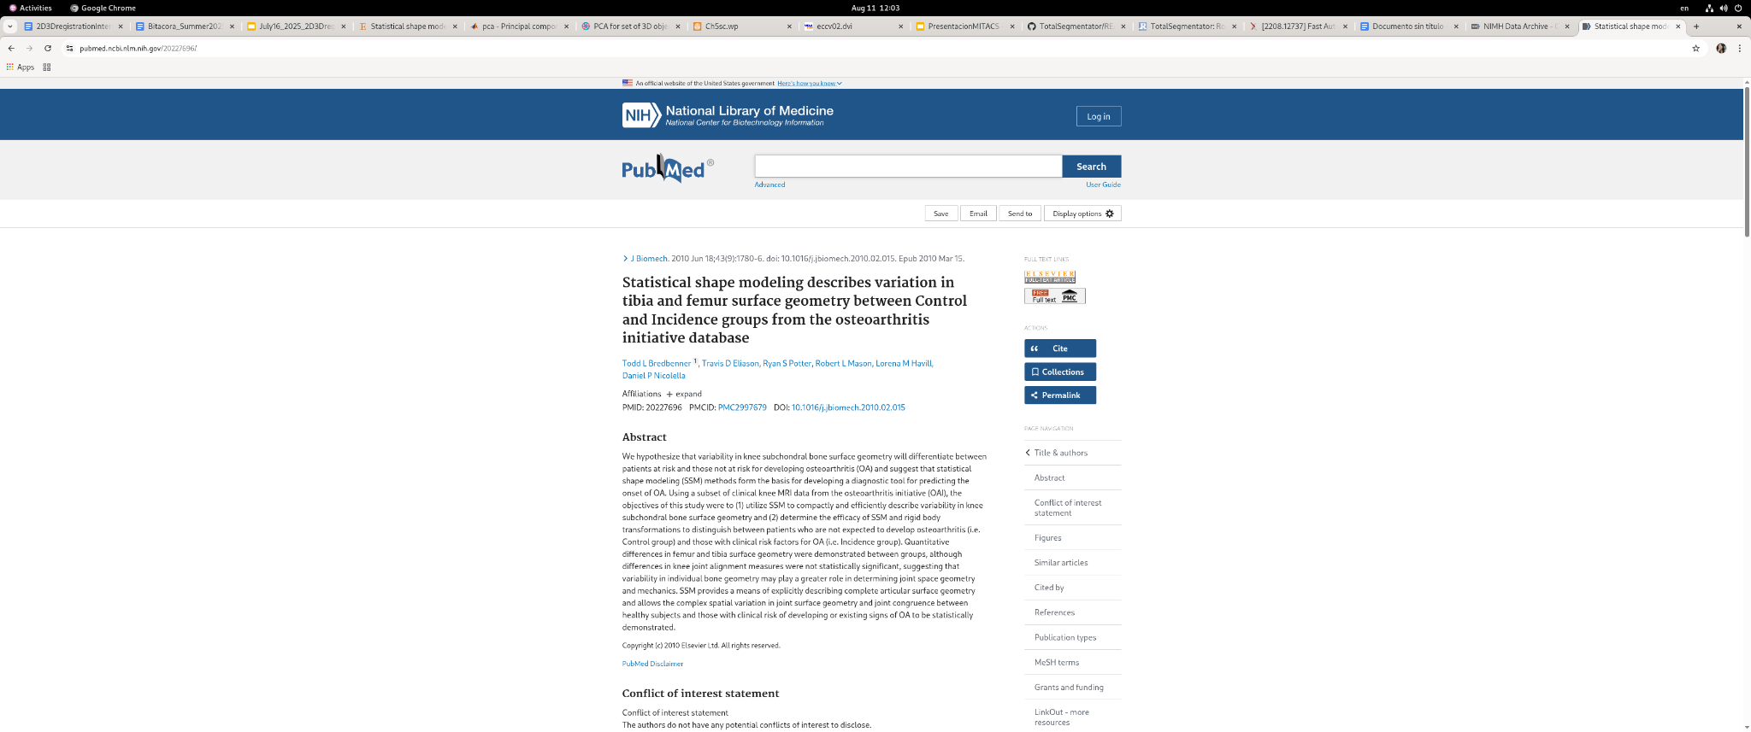
These are just some of the references reviewed; the complete list of literature is available in the internship documentation.

Slide 6
03
Dataset Search & Selection

Slide 7
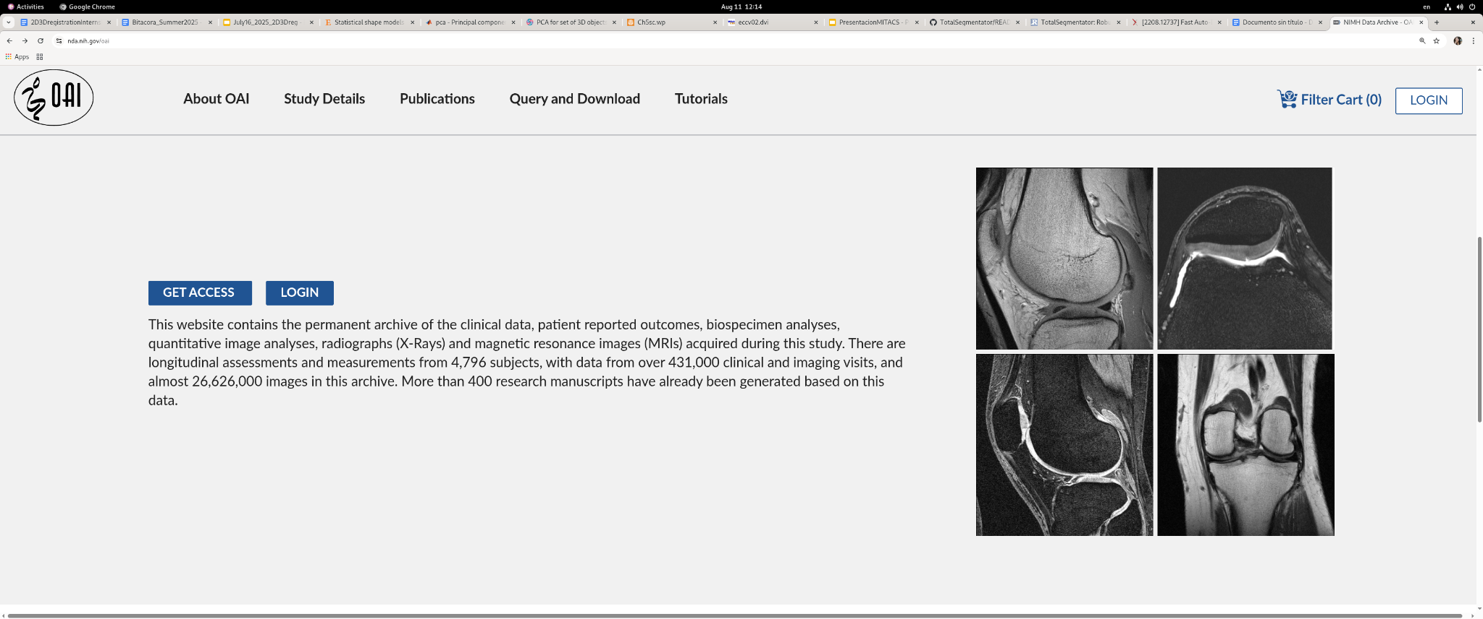

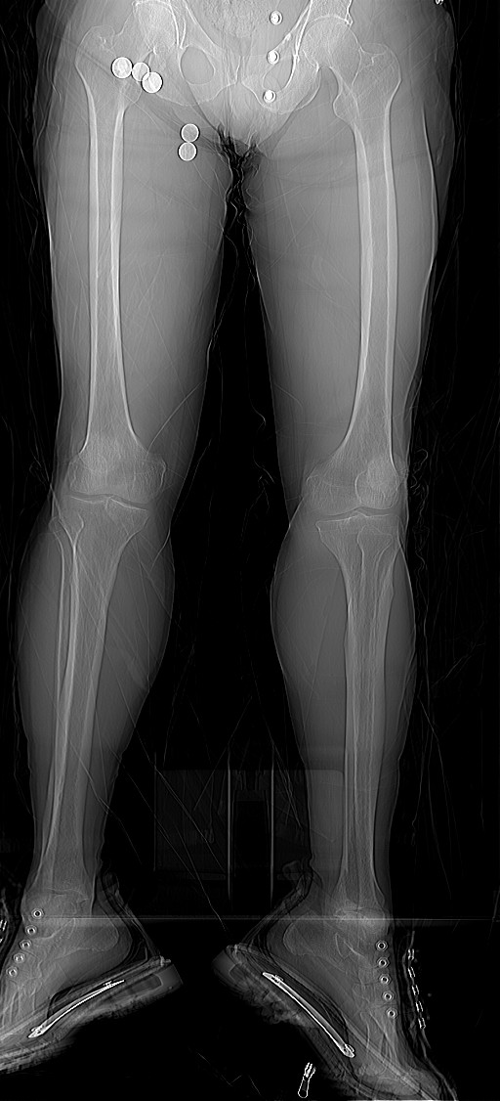

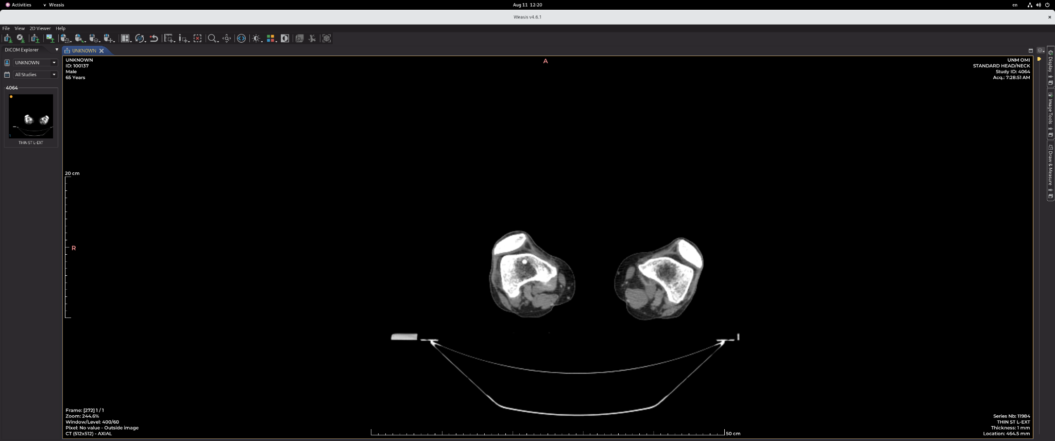
- Started with OIA dataset (knee X-rays) → not suitable for long-term goals.
- Moved to NMDID (full-body XR + CT). - Main issue: femur cropped → decided to work with tibia instead.
OAI | NMDID
Large documentation | Few documentation
The dataset was already downloaded by colleague | Dataset acquisition process is tedious and not fully automated
Quality images with all subject information. | Post-mortem subjects.
Few full limb data | Femur is cropped on CT

Slide 8
04
Data Preprocessing & Conversion

Slide 9

Downloaded 30 NMDID subjects.
Automated DICOM → NIfTI (.nii) conversion for easier handling (1 mm resolution).
Ensured reproducibility for future larger datasets.
The data set download can be found on the hard disk of the laboratory.

Slide 10
05
DRR Generation & 2D–3D Registration

Slide 11
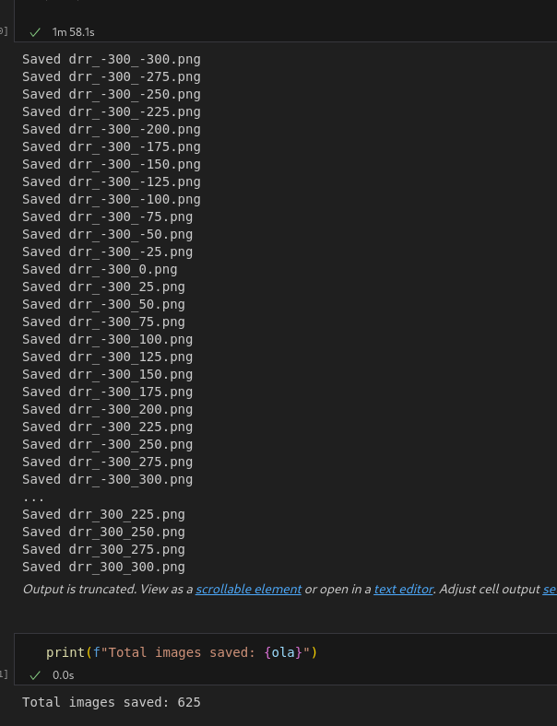
Goal: simulate radiographs from 3D volumes (different angles) → use for registration optimization.
Explored multiple methods → selected diffDRR:
• Based on Siddon’s method (ray tracing).
• GPU accelerated with CUDA → faster.
- Limitation: high GPU memory usage, requires careful parameter tuning. - Performance: 625 DRRs in ~2 min.
Gopalakrishnan, V. and Golland, P. (2022). Fast Auto-Differentiable Digitally Reconstructed Radiographs for Solving Inverse Problems in Intraoperative Imaging. [online] arXiv.org. Available at: https://arxiv.org/abs/2208.12737.

Slide 12
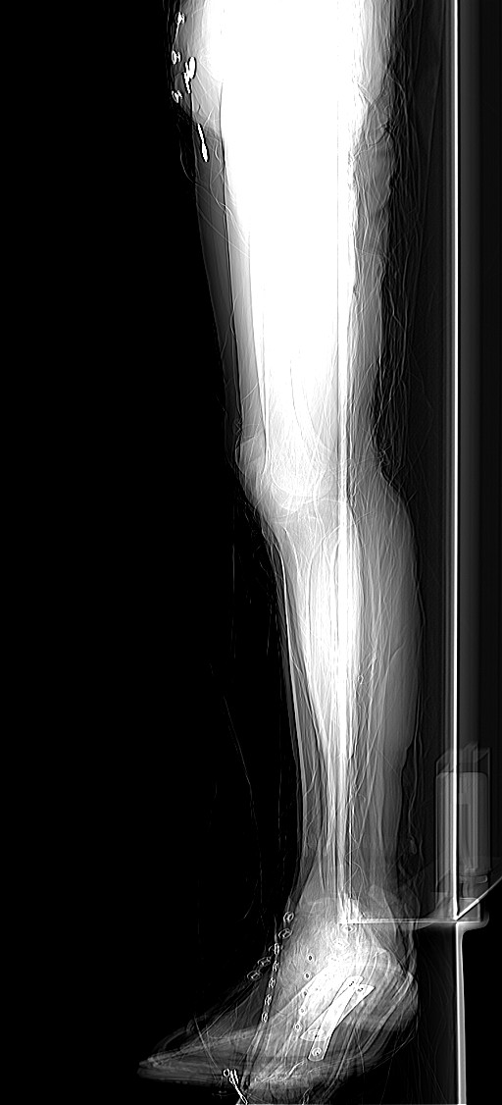
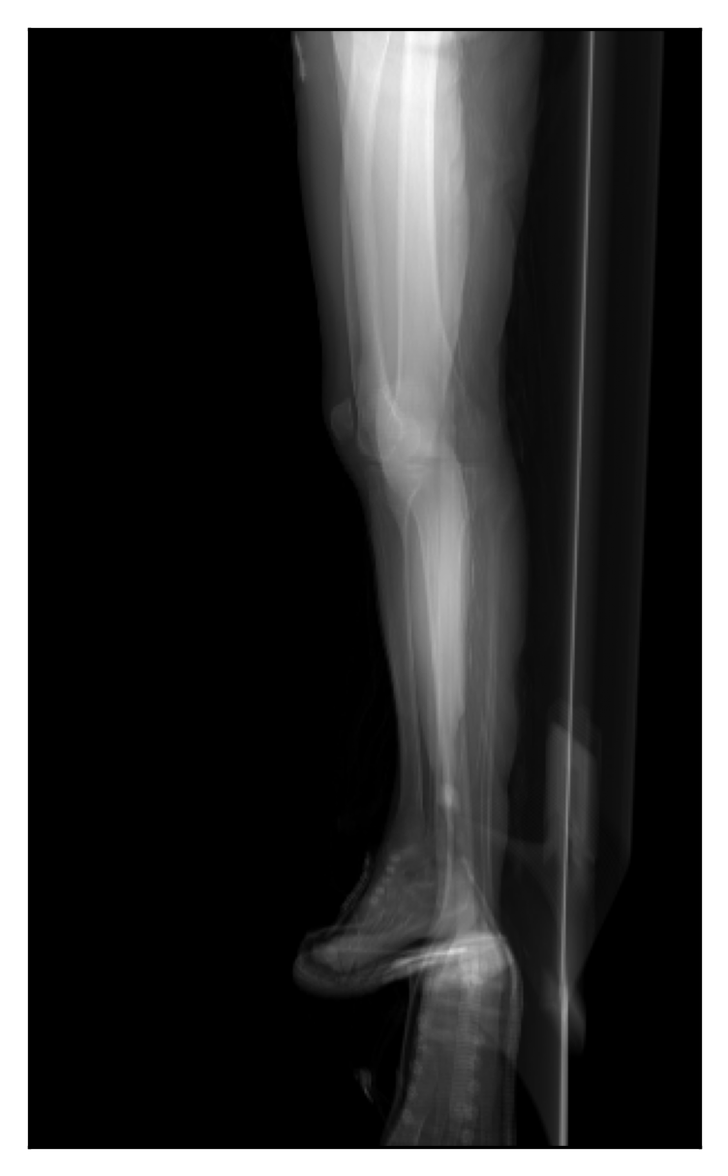
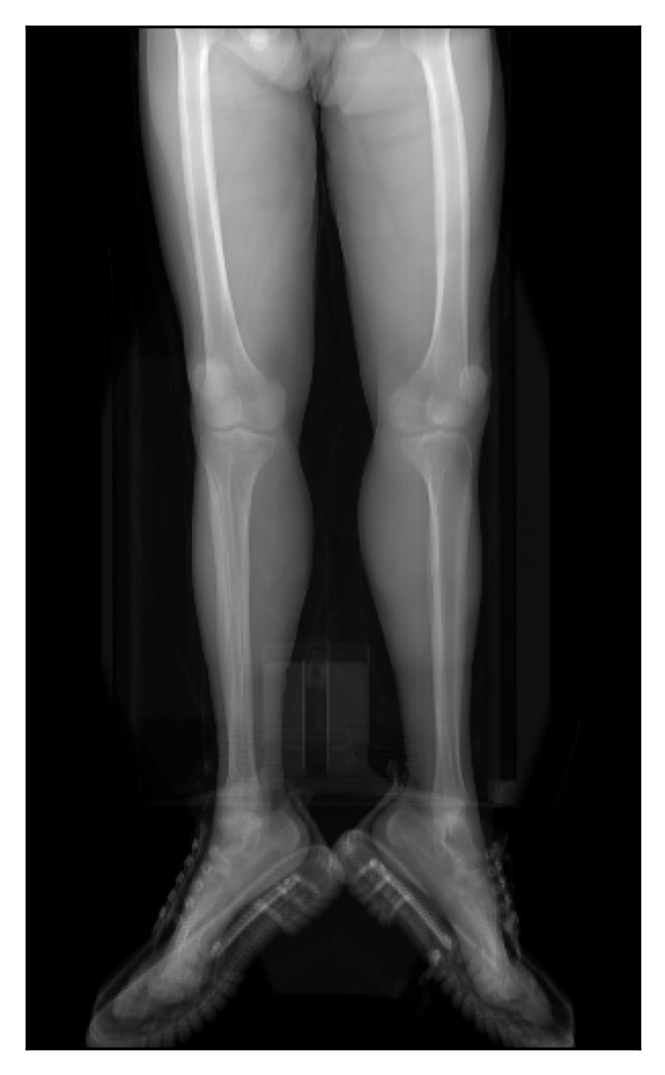
Real X-ray DRR Real X-ray DRR

Slide 13
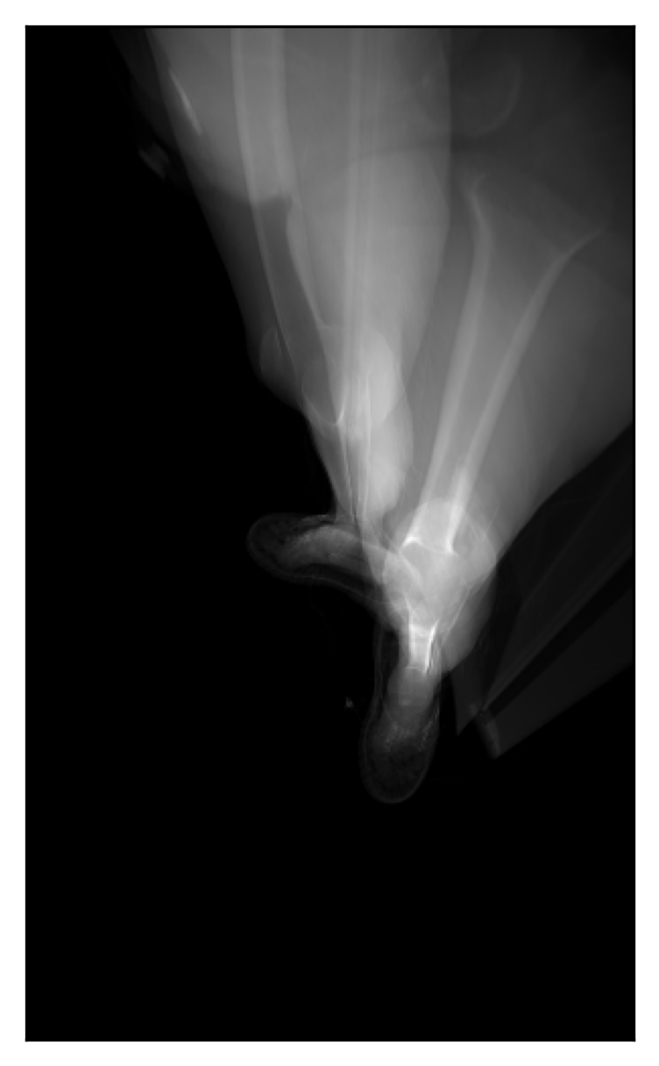
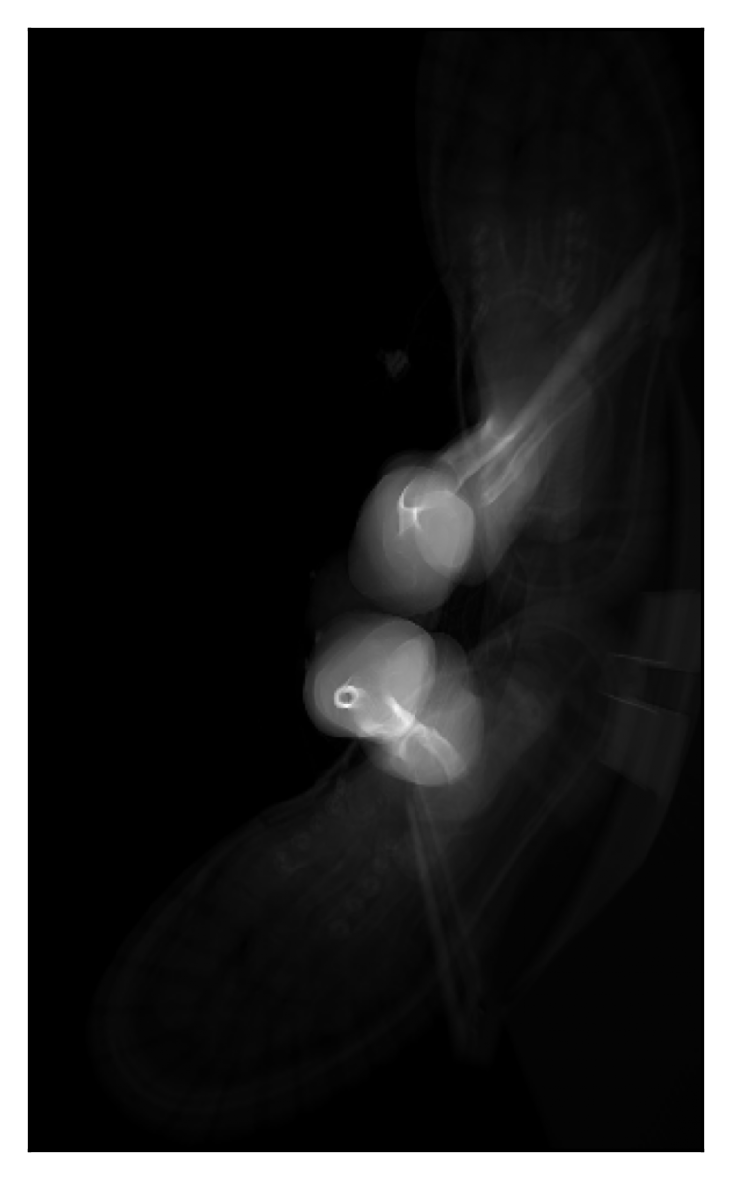
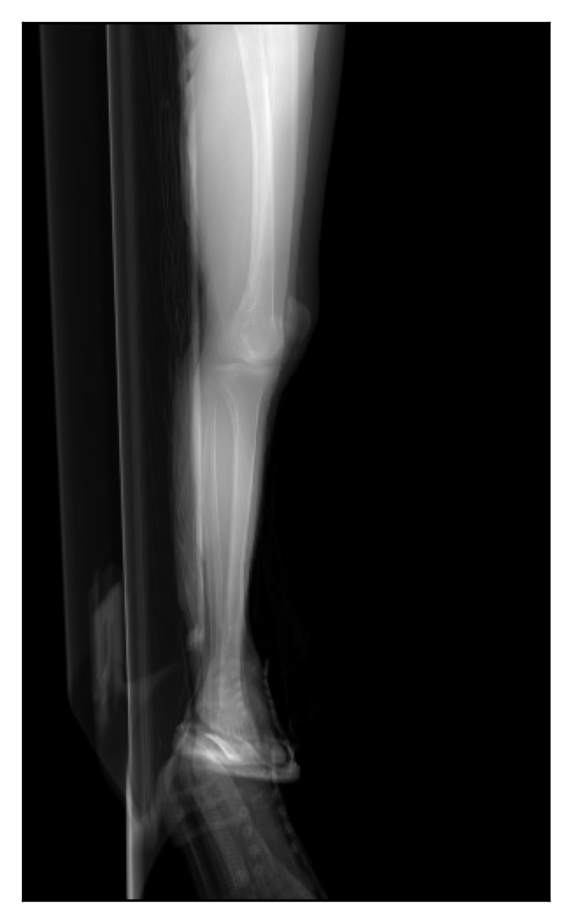
Different angles obtained with the diffDRR method of the NMDID dataset.

Slide 14
06
Automatic 3D Segmentation

Slide 15
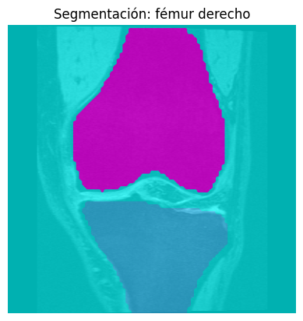
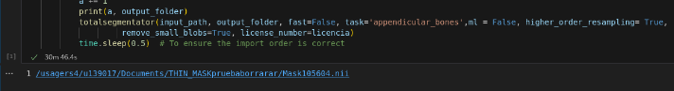
- Need: fast, high-quality bone segmentation from CT/MRI.
- Evaluated options → chose TotalSegmentator:
• Trained on large datasets.
• Dice ≈ 0.943 for bones.
- Automated tibia segmentation.
- For 15 masks ~30 min
First attempt using OIA dataset and MRI model.
We just followed the documentation on the official repository, our script is commented with all the steps.
Jakob Wasserthal, Breit, H.-C., Meyer, M.T., Pradella, M., Hinck, D., Sauter, A., Heye, T., Boll, D.T., Cyriac, J., Yang, S., Bach, M. and Segeroth, M. (2023). TotalSegmentator: Robust Segmentation of 104 Anatomic Structures in CT Images. Radiology, 5(5). doi:https://doi.org/10.1148/ryai.230024..

Slide 16
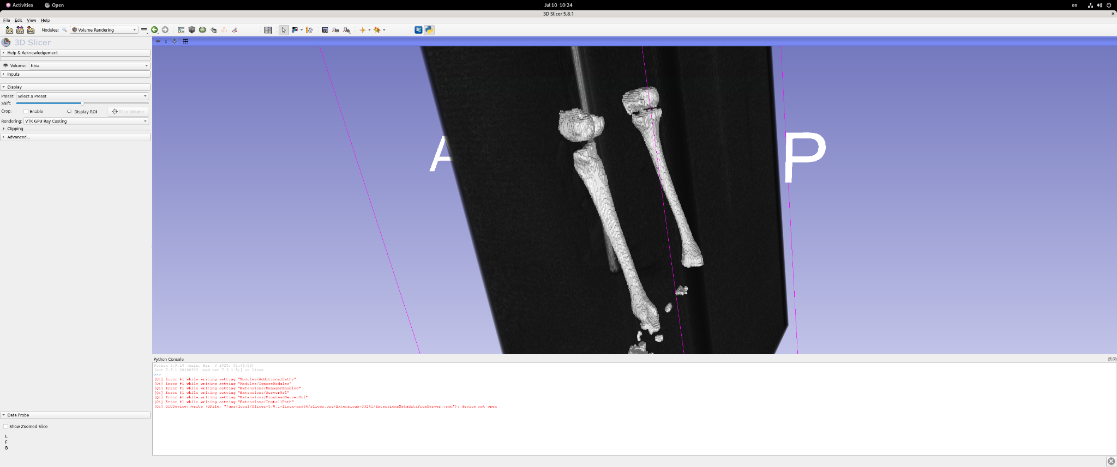
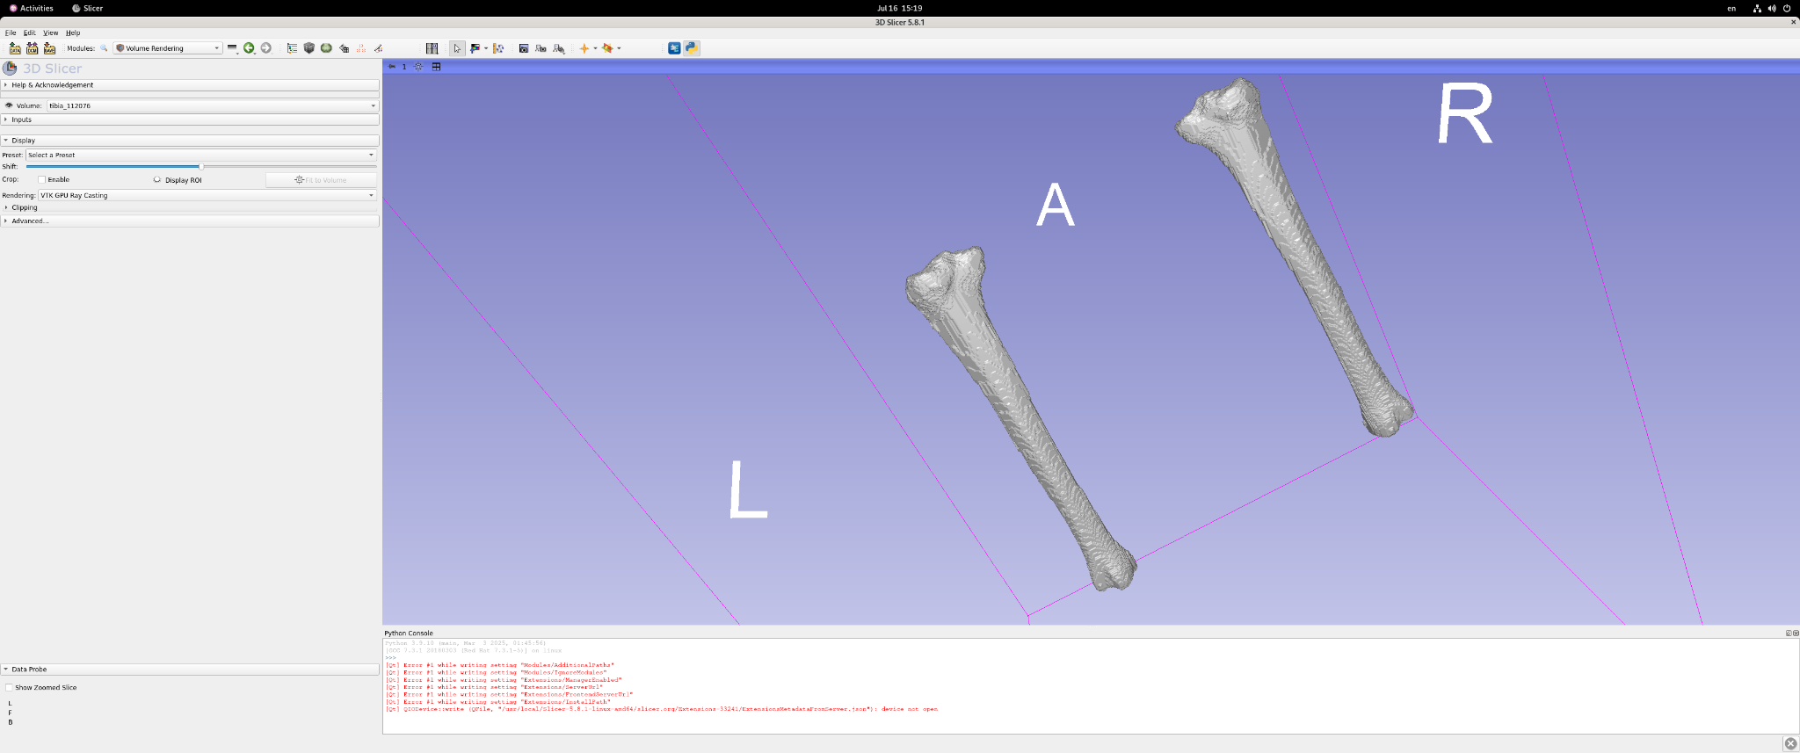
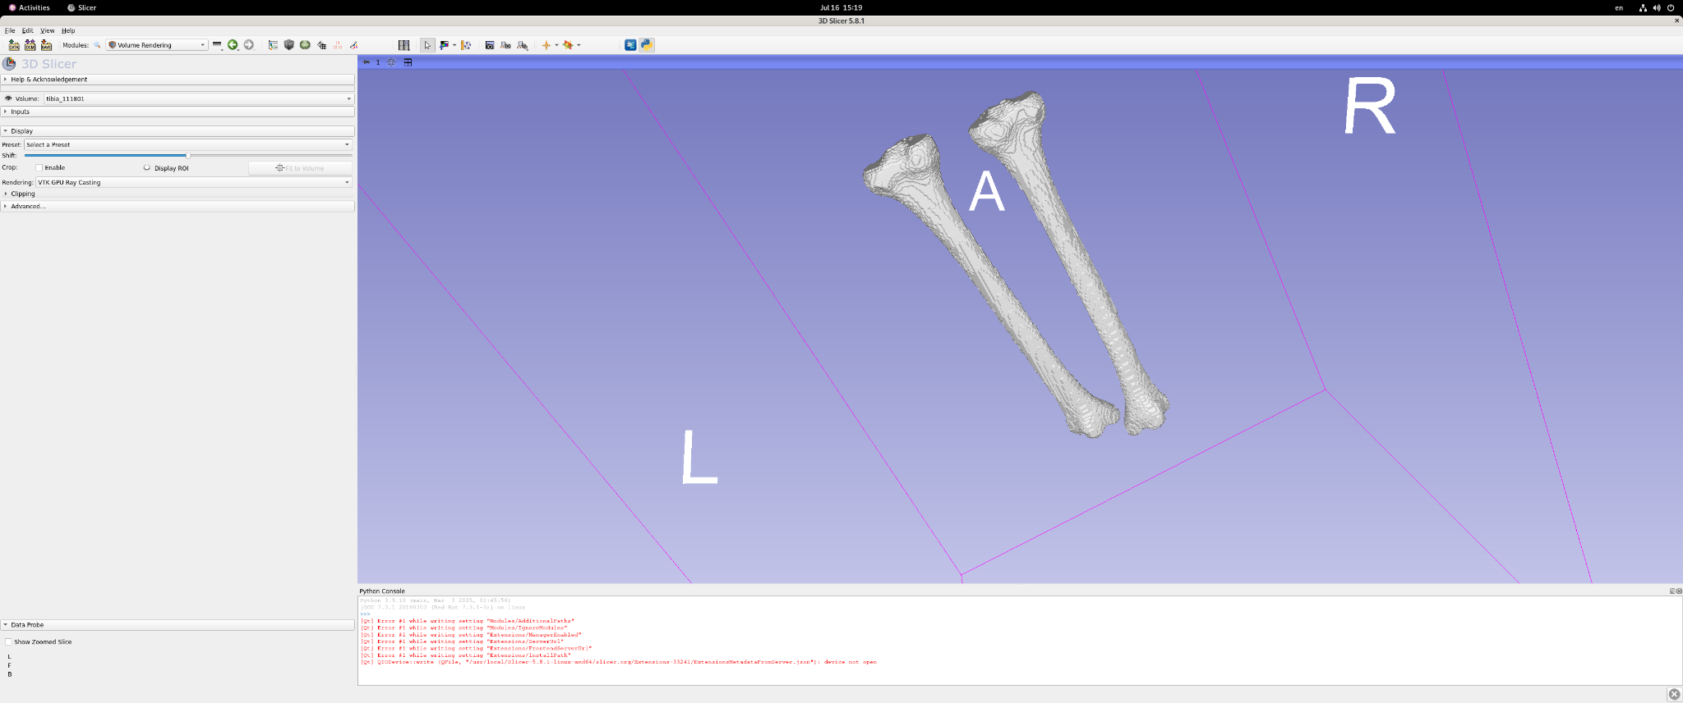
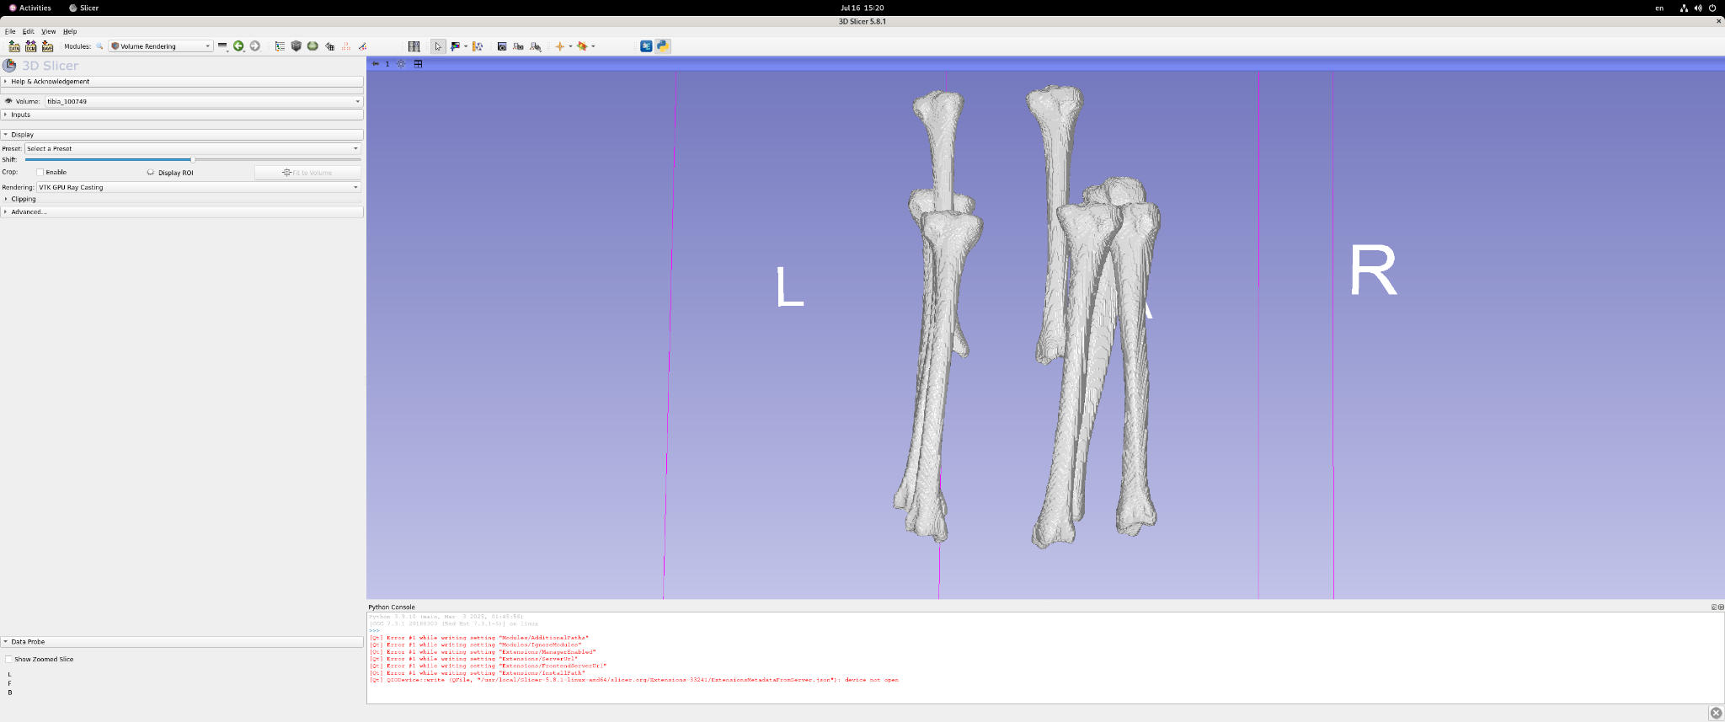
We were able to obtain good tibia segmentation of 23 out of 30 subjects.

Slide 17
07
Post-processing Segmentation

Slide 18
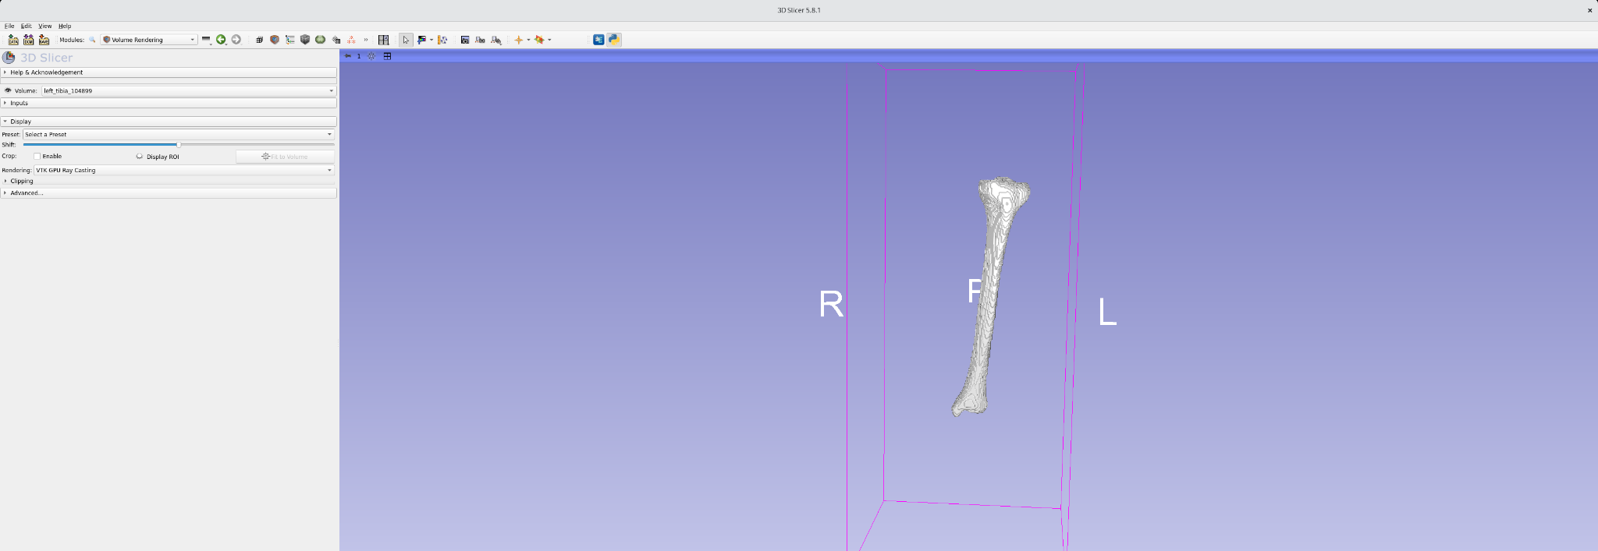
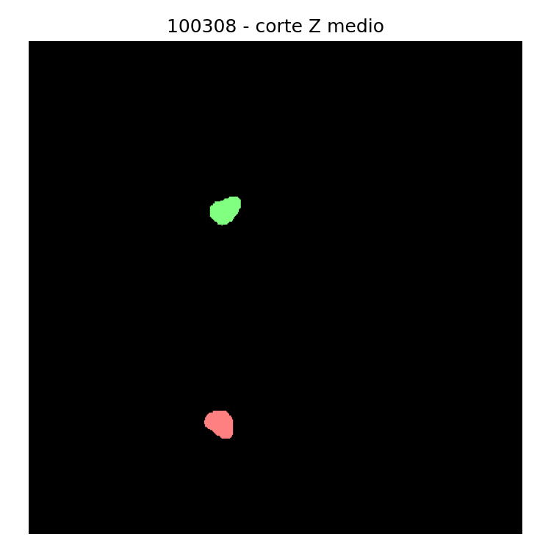
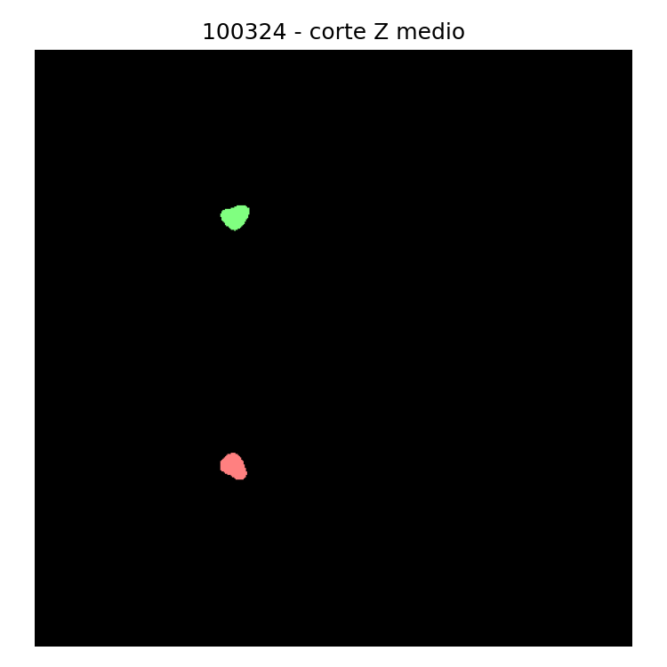
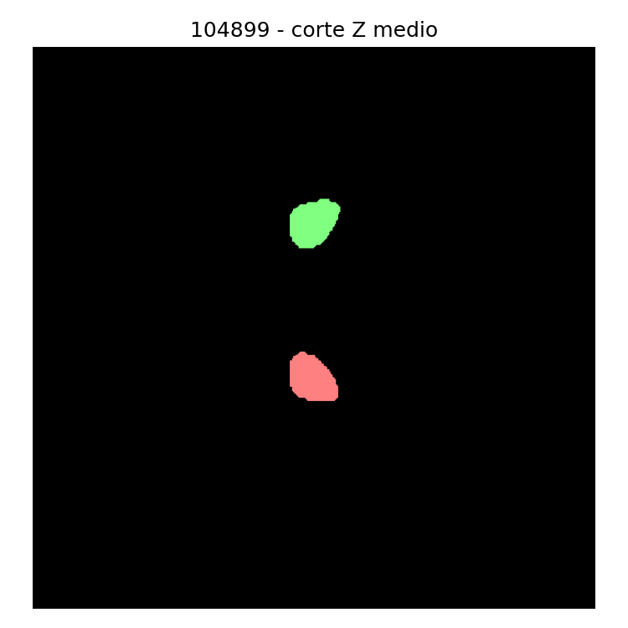
Since we needed to have the tibias separated between left and right, as well as clean masks:
- Removed small blobs via connected components.
- Separated left vs right tibia automatically.
- Result: clean, well-isolated masks ready for modeling.

Slide 19
08
Shape Statistical Model (SSM) – Attempt 1

Slide 20
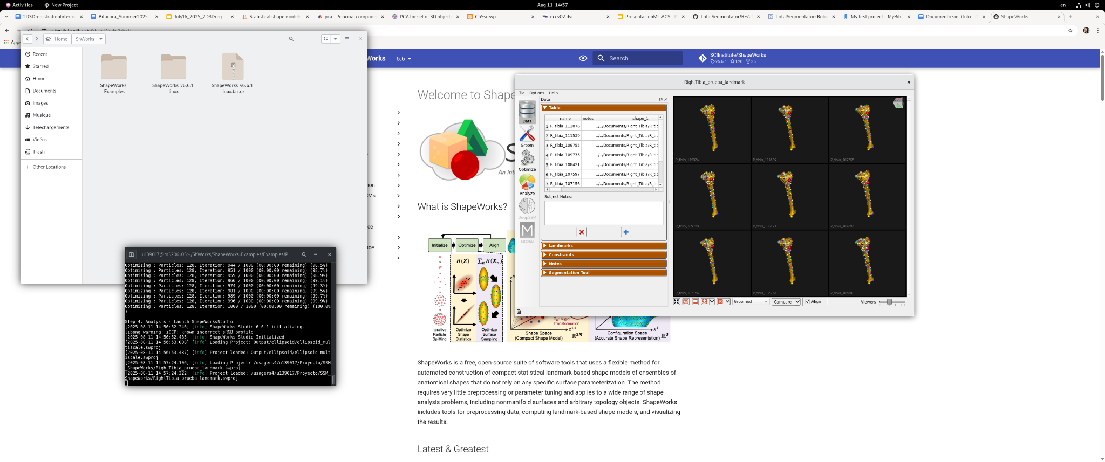
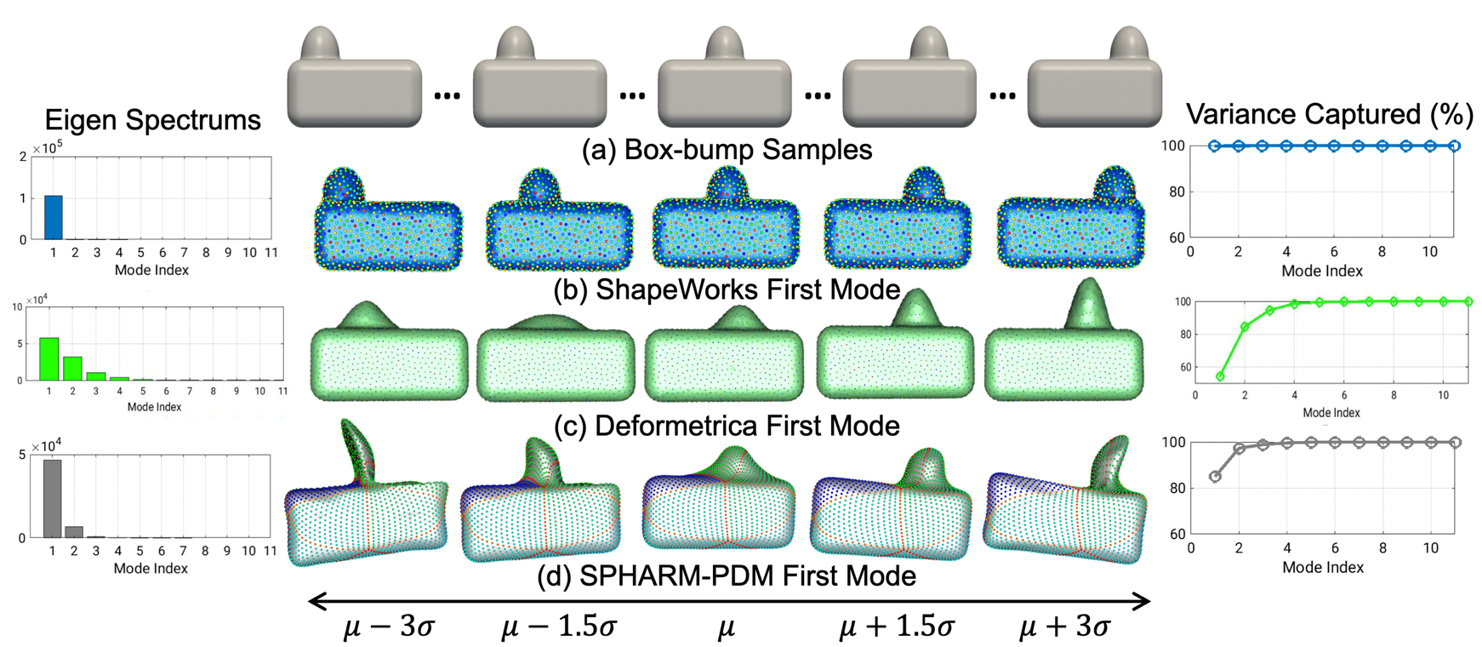
- Tried ShapeWorks (good paper, GUI only).
- Couldn’t access/modify internal code (registration & PCA process unclear).
- Decided to implement own method instead.
Guoyan Zheng, Li, S. and Gábor Székely (2017). Statistical shape and deformation analysis : methods, implementation and applications. London: Academic Press, An Imprint Of Elsevier.

Slide 21
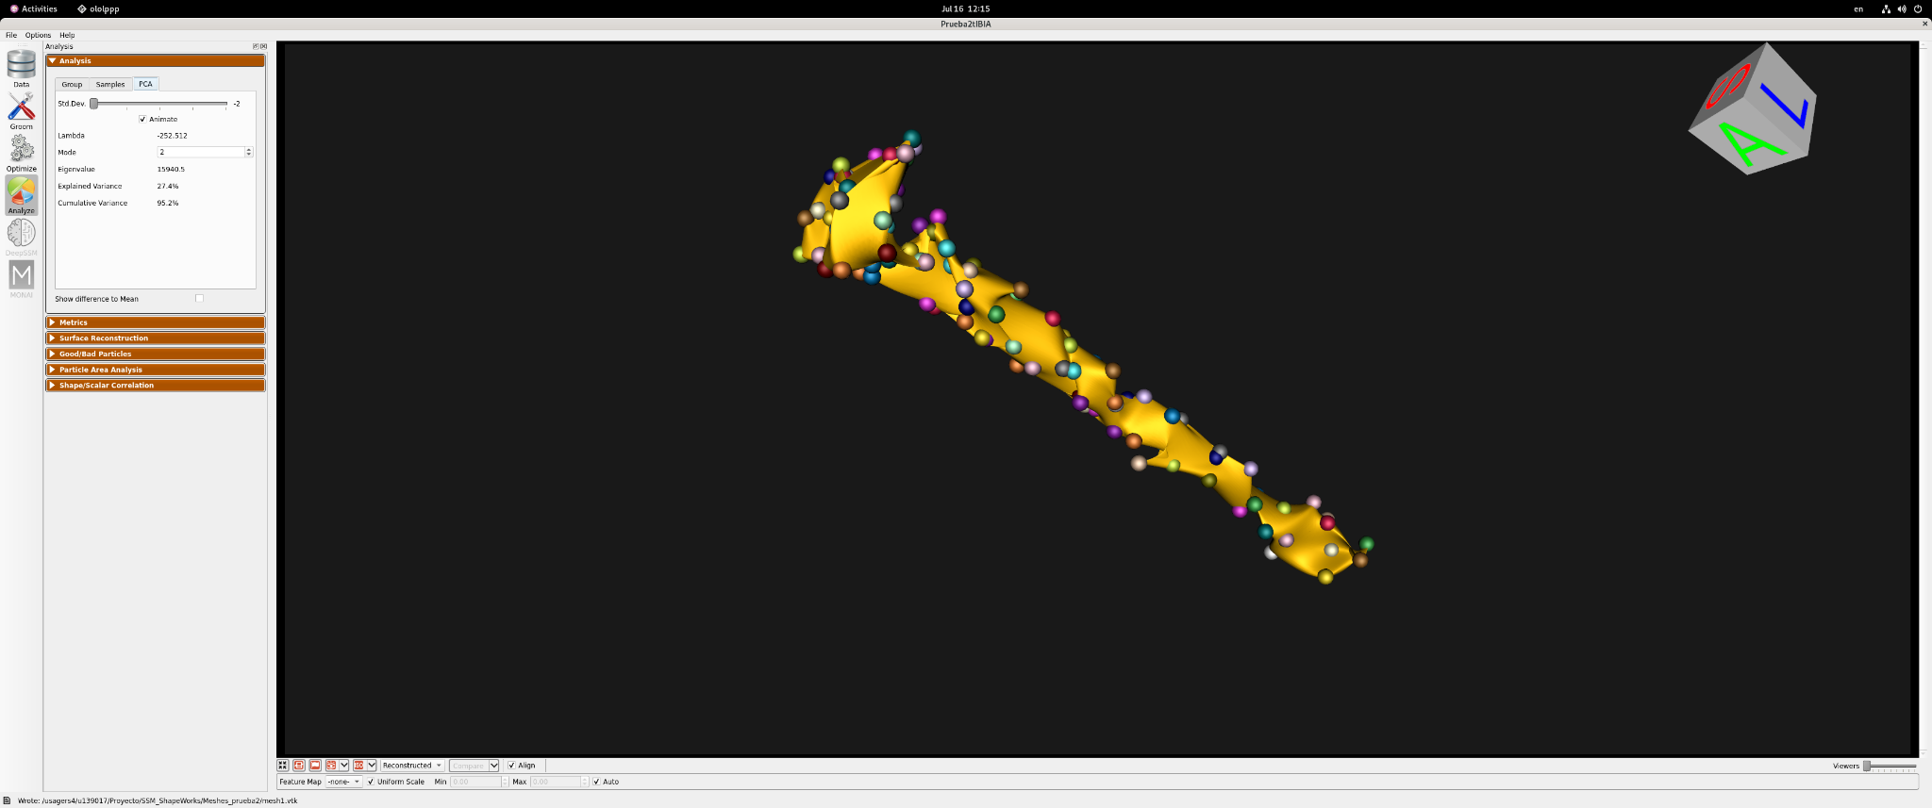
First attempt using the optimization method to obtain the correspondence.

Slide 22
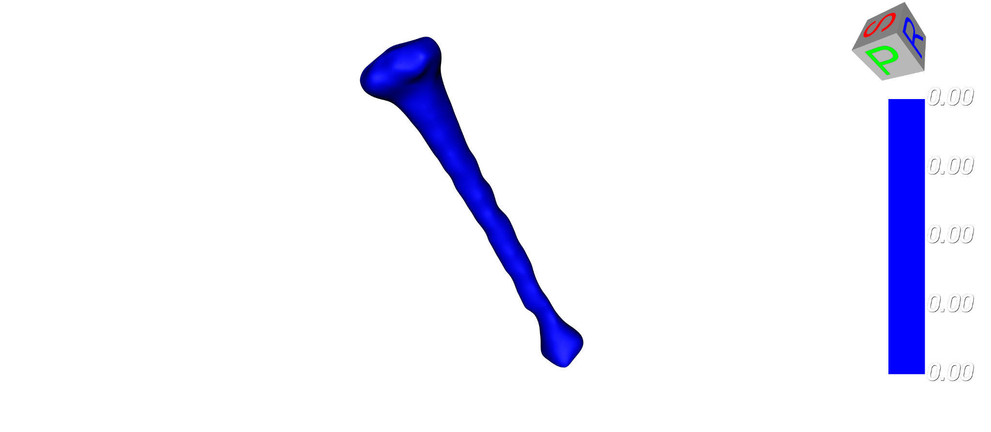
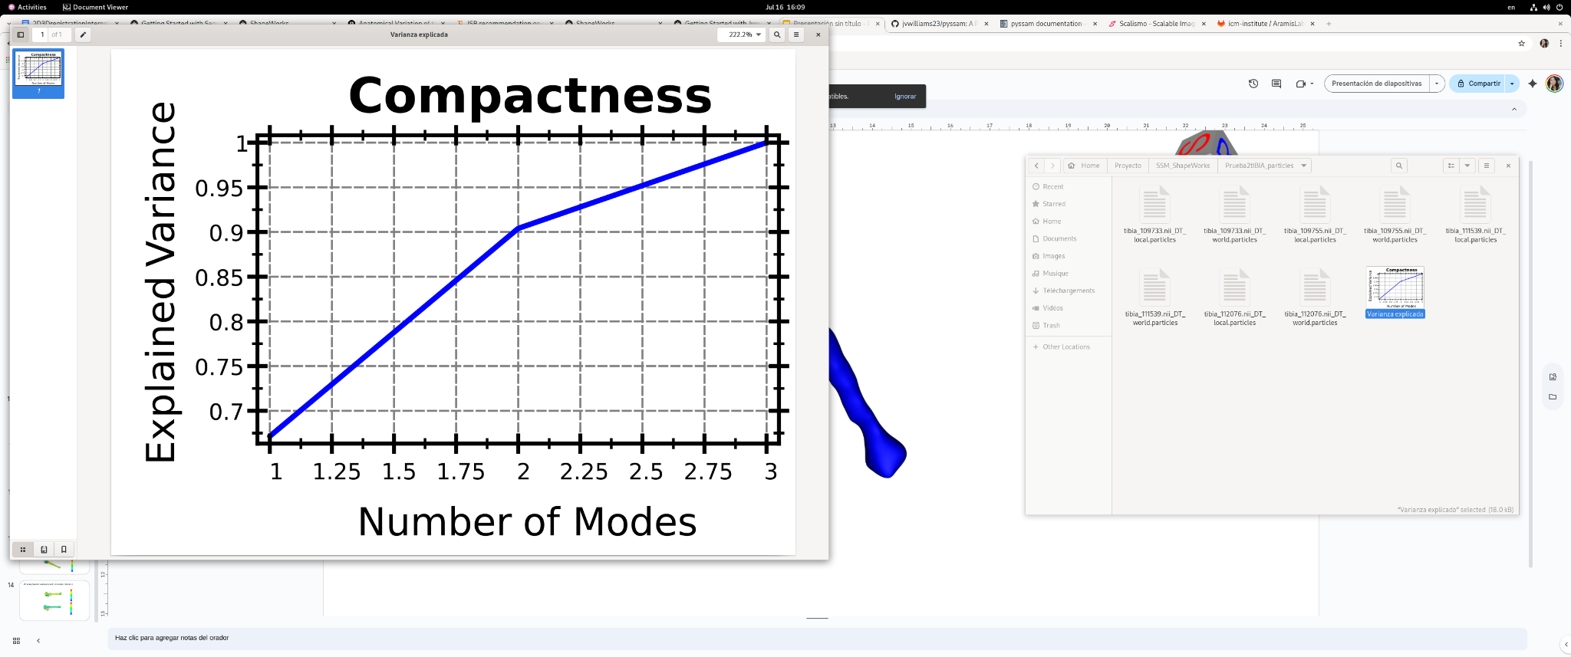
PCA obtained with manual landmark correspondence
Since we wanted to automatize the process, we decided to explore other tools.

Slide 23
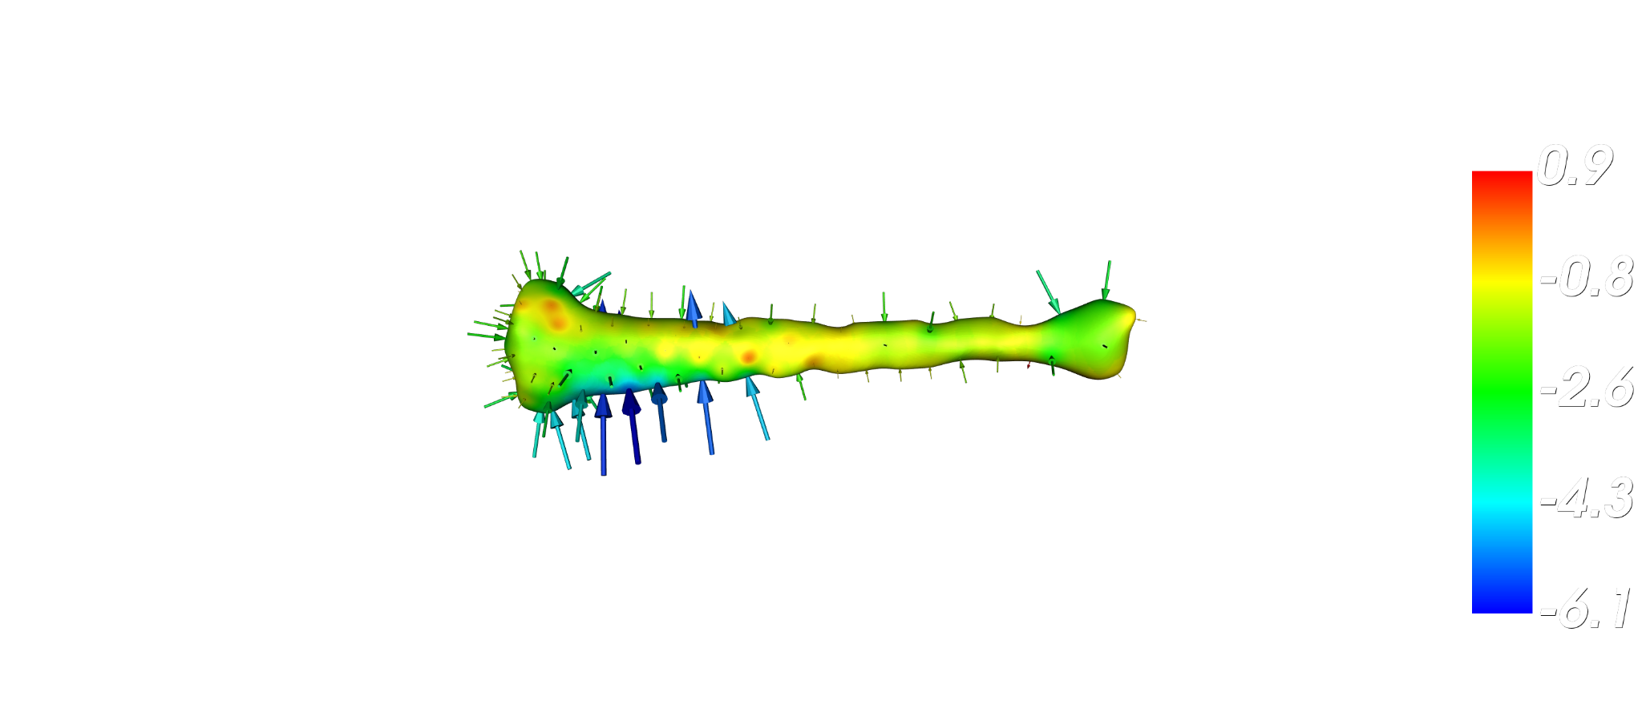
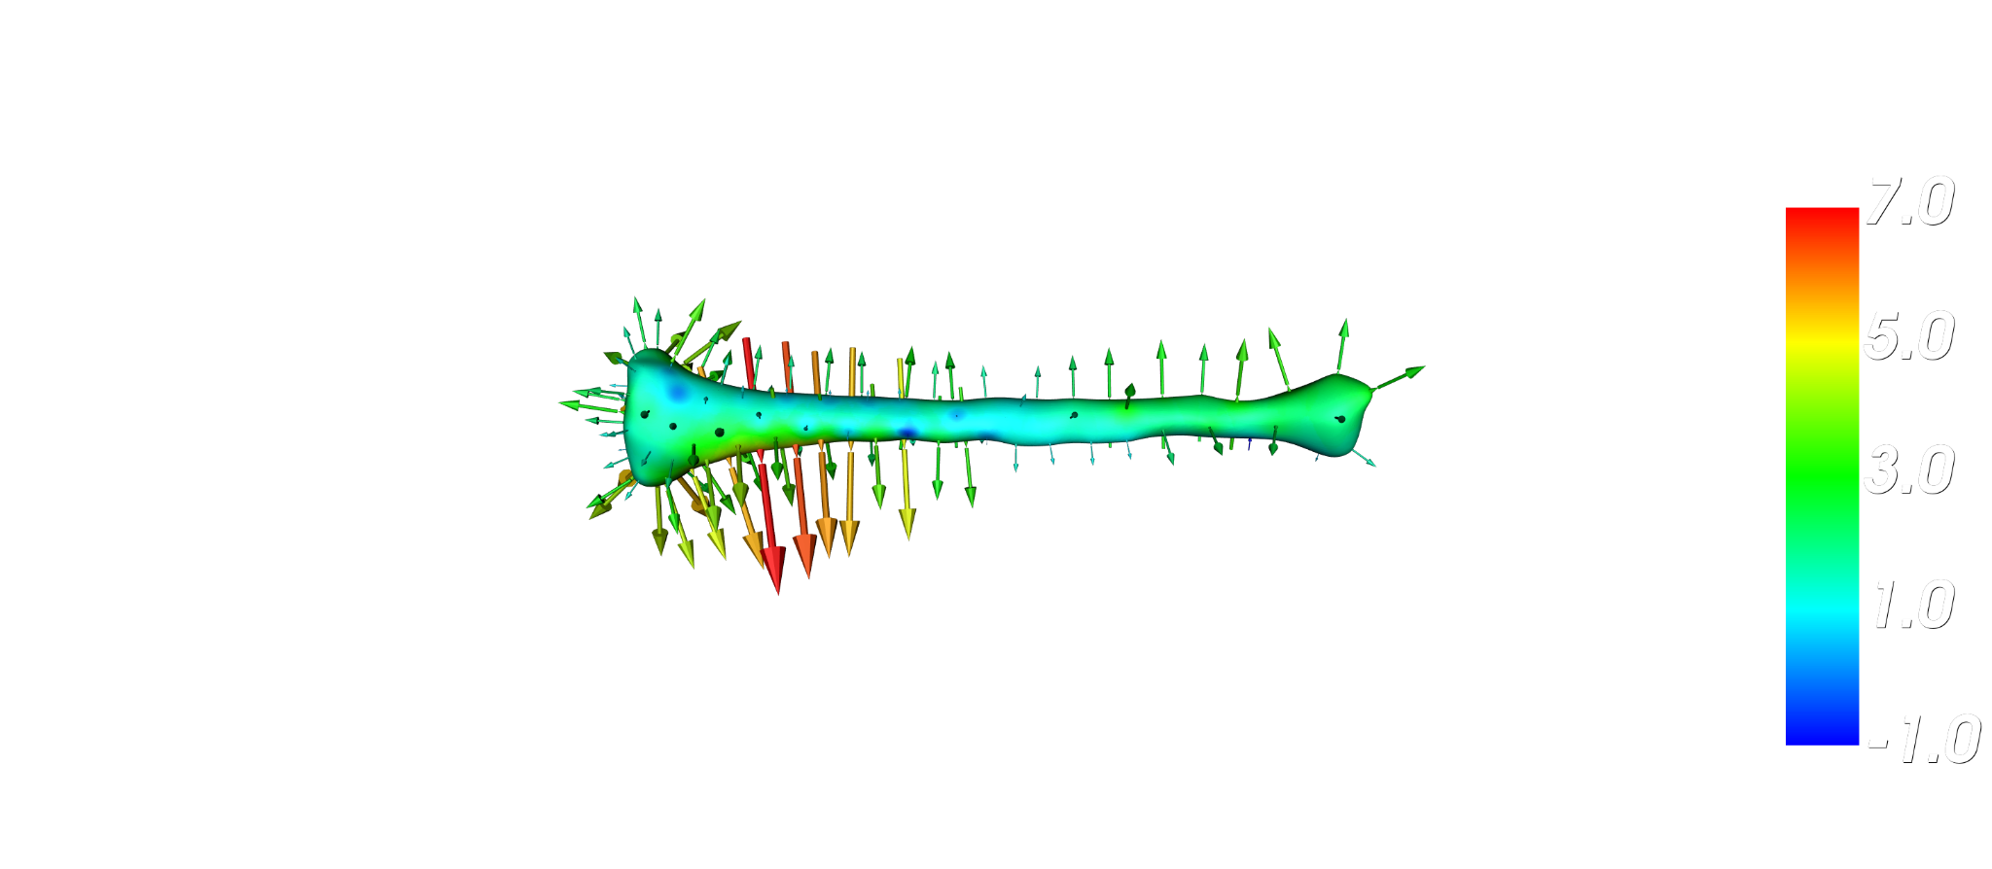
PCA Explained variance with 3 modes: Mode 3

Slide 24
09
Shape Statistical Model (SSM) – Custom Implementation

Slide 25
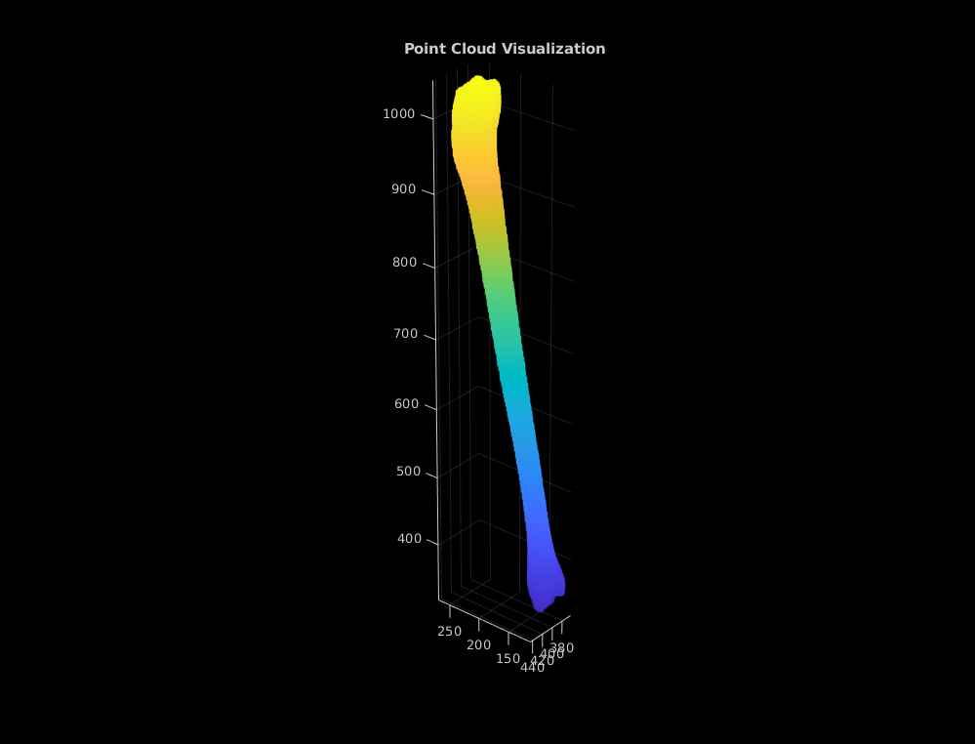
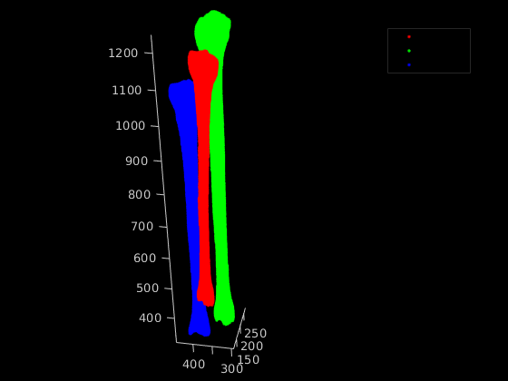
- Implemented in MATLAB (due to prior familiarity).
- Steps:
1. Align point clouds (Coherent Point Drift – rigid mode).
2. Choose smallest-point-count template → map all others to it (Nearest Neighbour).
3. Visualize correspondences with color mapping → good results.
- Obtained average tibia → starting PCA.

Slide 26

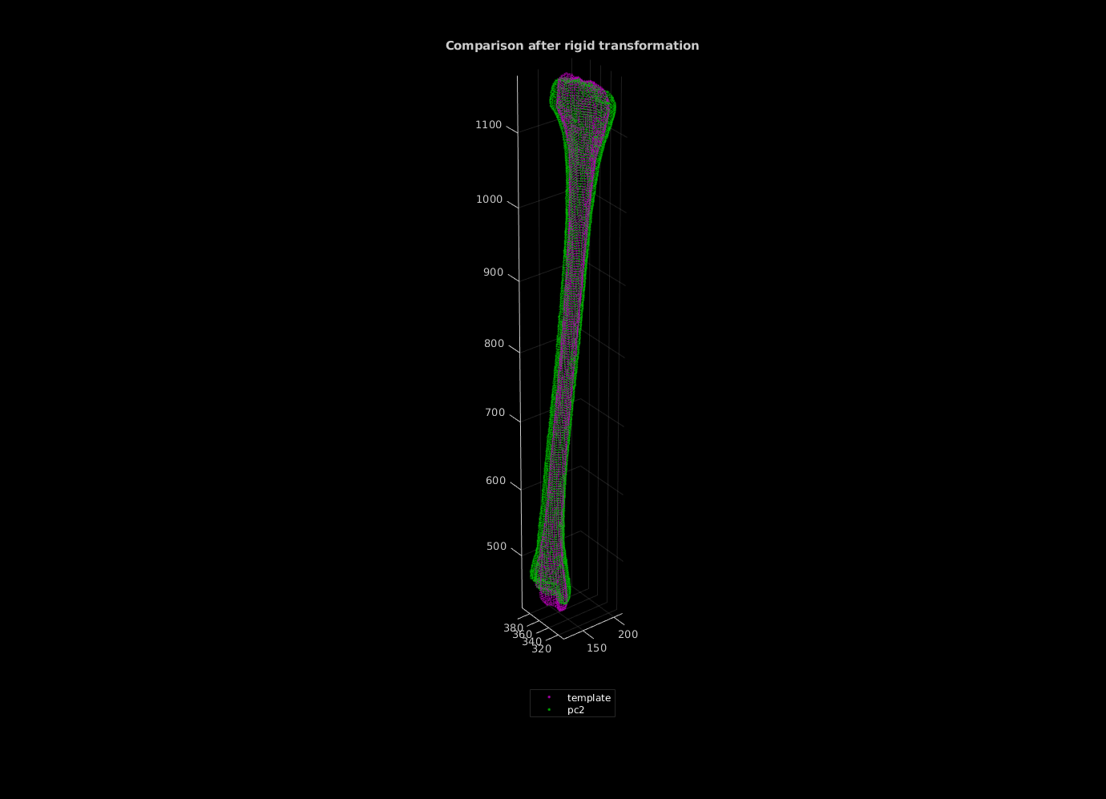
1. Align point clouds (Coherent Point Drift – rigid mode).
Myronenko, A., and X. Song. "Point Set Registration: Coherent Point Drift. "Proceedings of IEEE Transactions on Pattern Analysis and Machine Intelligence (TPAMI)." Vol 32, Number 12, December 2010, pp. 2262–2275.
https://www.mathworks.com/help/vision/ref/pcregistercpd.html

Slide 27
2. Choose smallest-point-count template → map all others to it (Nearest Neighbour).
KNN for correspondence map
TemIdx | KNNpc1Idx
6496 | 12600
6497 | 12682
6498 | 12682
6499 | 13643
6500 | 13643
TemIdx | KNNpc2Idx
6496 | 9072
6497 | 9078
6498 | 9072
6499 | 9197
6500 | 9197
[idx, dist] = knnsearch(template.Location, pc2_rigid.Location);
[idx, dist] = knnsearch(template.Location, pc2_rigid.Location);
At first we were trying to fit the points into the template, but we decided to swap and fit the template into the other point clouds. This way we can have the same number of points, as well as the same idx for the correspondence.
https://www.mathworks.com/help/stats/knnsearch.html

Slide 28
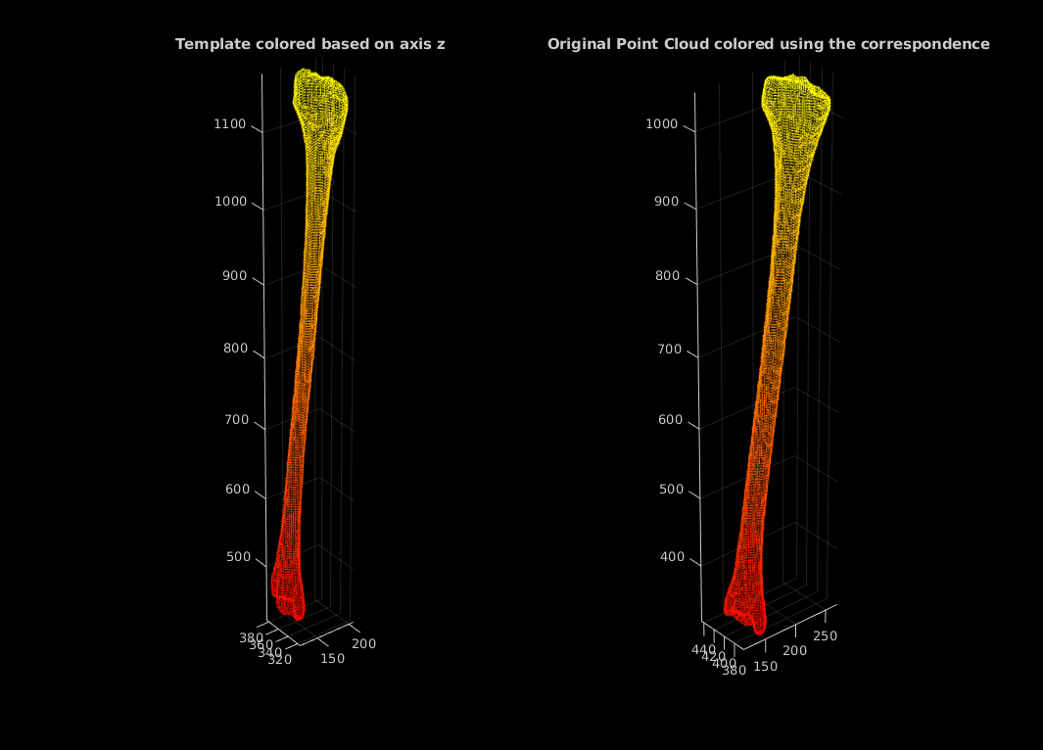
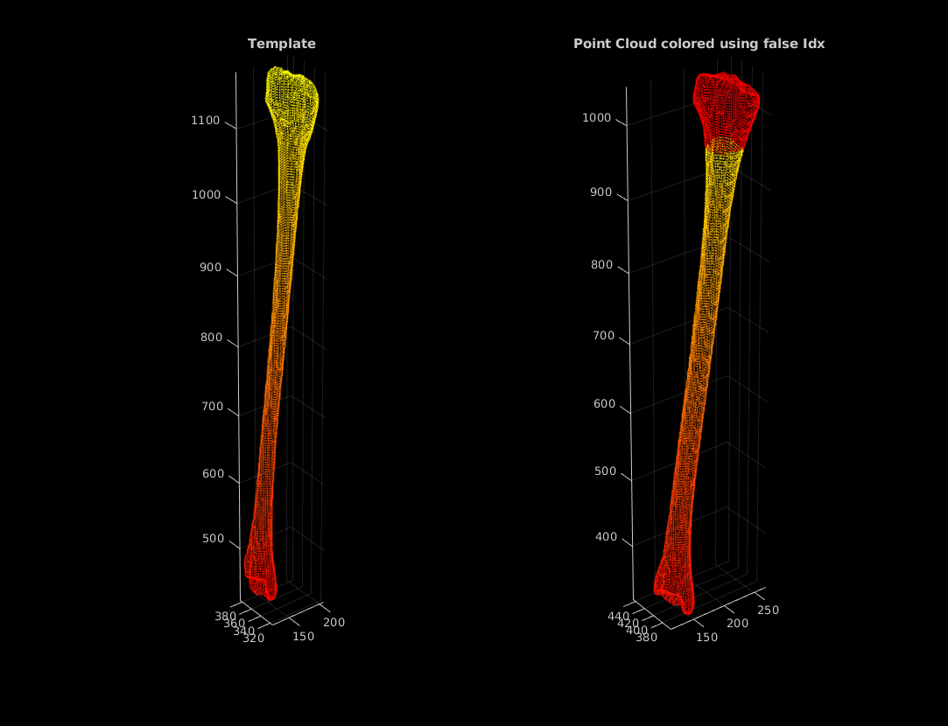
2.1 Validate correspondence map. (Replace last index with a false map)

Slide 29
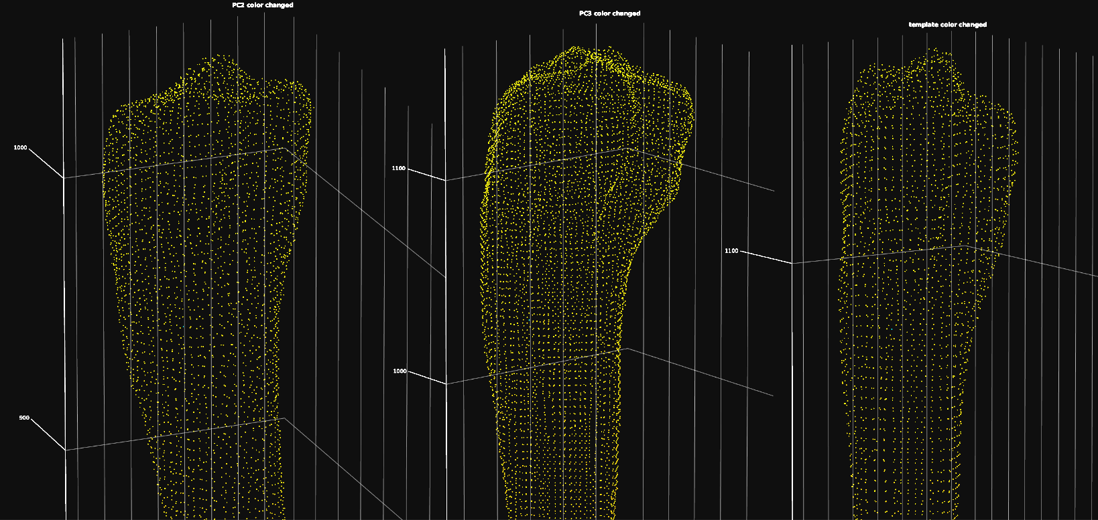
2.1 Validate correspondence map
In here we used the same index to change the color, visualizing if the same area or point was changed for the 3 tibias.

Slide 30
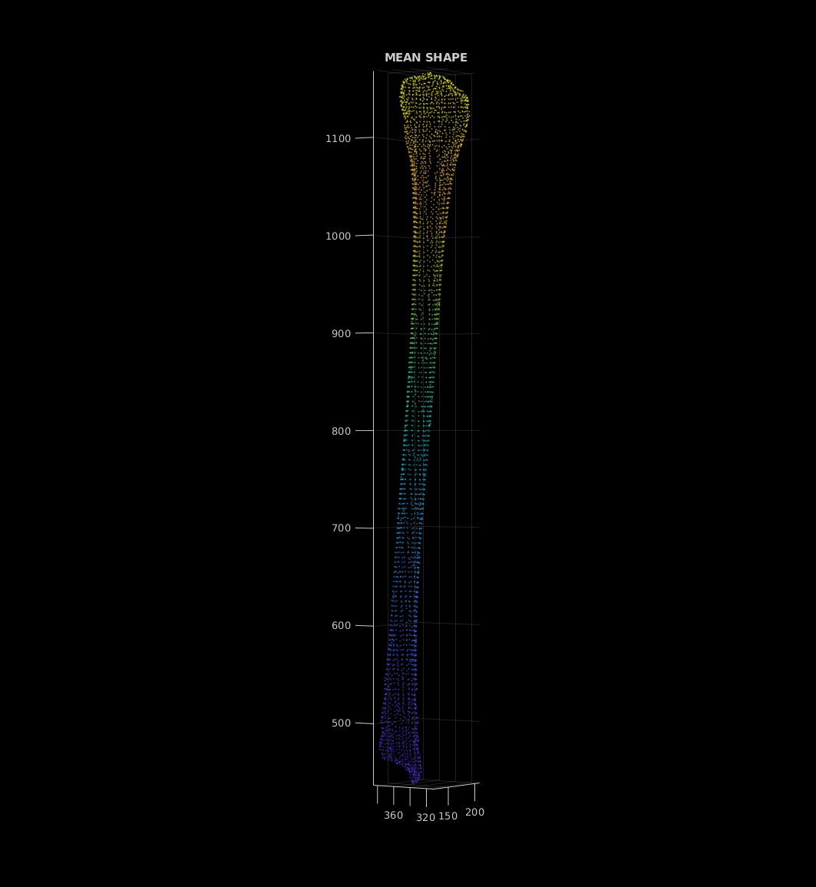
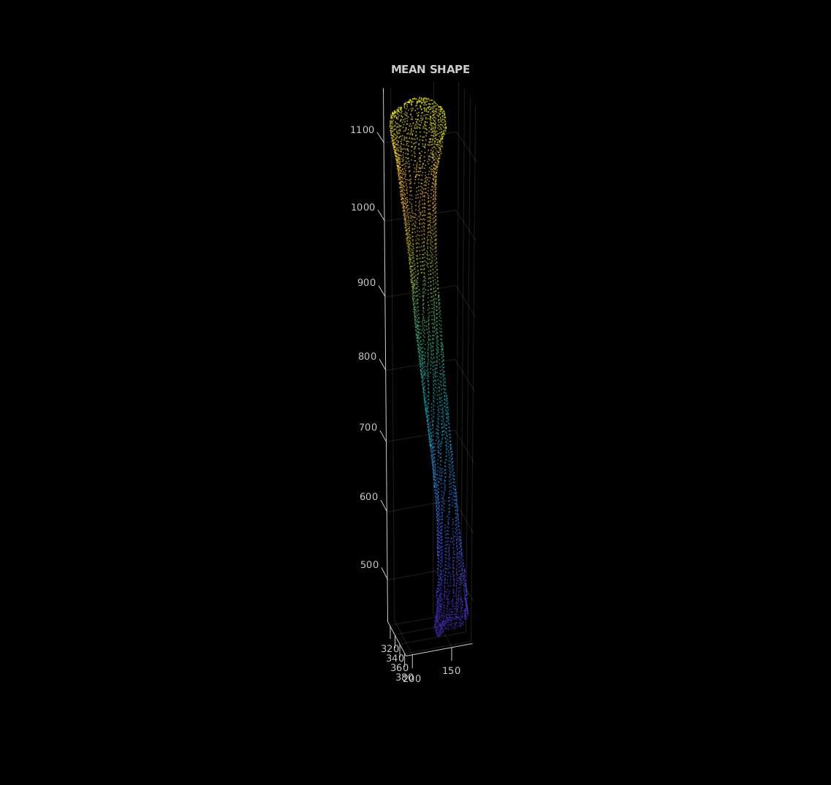
2.2 Mean Shape: iterative method.

Slide 31
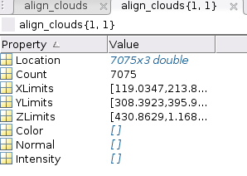
3.1 Converting Point Cloud Structures into an (N × 3 × n) Matrix with Correct Point Correspondence
n (subjects)
Coordinates in 3D
N Number of points

Slide 32
3.2 Flattening 3D Coordinates into Vectors to Form a (3N × n) Matrix
n (subjects)
n (subjects)
Coordinates in 3D
reshape(mat, [N*3, n])
N Number of points
3N

Slide 33




3.3 Computing the Mean Shape and the Empirical Covariance Matrix
Given p as the flattened matrix representation, the computation can be expressed compactly using matrix operations.
Nsubj = n (number of tibias)
Bredbenner, T.L., Eliason, T.D., Potter, R., Mason, R.J., Havill, L.M. and Nicolella, D.P. (2010). Statistical shape modeling describes variation in tibia and femur surface geometry between Control and Incidence groups from the Osteoarthritis Initiative database. Journal of Biomechanics, 43(9), pp.1780–1786. doi:https://doi.org/10.1016/j.jbiomech.2010.02.015.

Slide 34
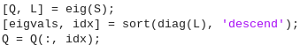
3.4 Computing eigenvalues and eigenvectors to obtain the PCA
With this, we can apply the transformations to each point using the eigenvalues and eigenvectors. Here, Q is the matrix containing the eigenvectors (principal directions), and L is the diagonal matrix containing all eigenvalues, which represent the variance explained by each mode.
shape_t = p_mean + alpha * sqrt(eigvals(modo)) * Q(:,modo);
verts_t = reshape(shape_t, [N_pts, 3]);
Once we have the mean shape, eigenvalues and eigenvectors. We used the p matrix(position) apply the different modes to the mean to see the performance of the tibia. To visualize, we just reshape back to the matrix Nx3xn.
Wolfgang Karl H©Þrdle, Simar, L. and Springerlink (Online Service (2015). Applied Multivariate Statistical Analysis. Berlin, Heidelberg: Springer Berlin Heidelberg.

Slide 35
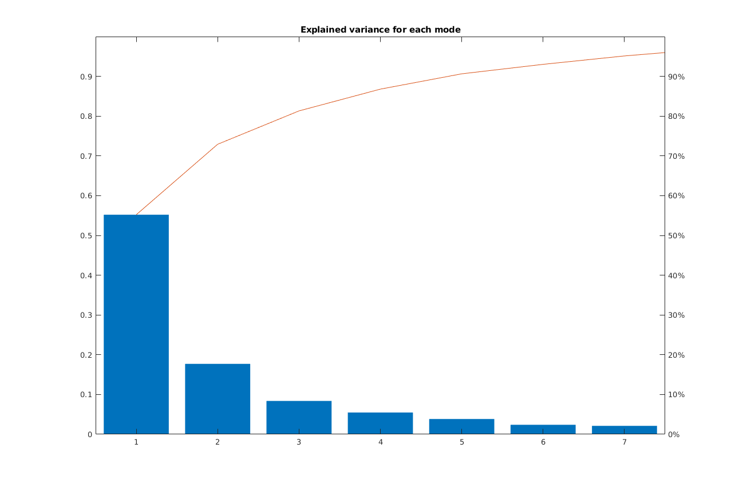

Slide 36
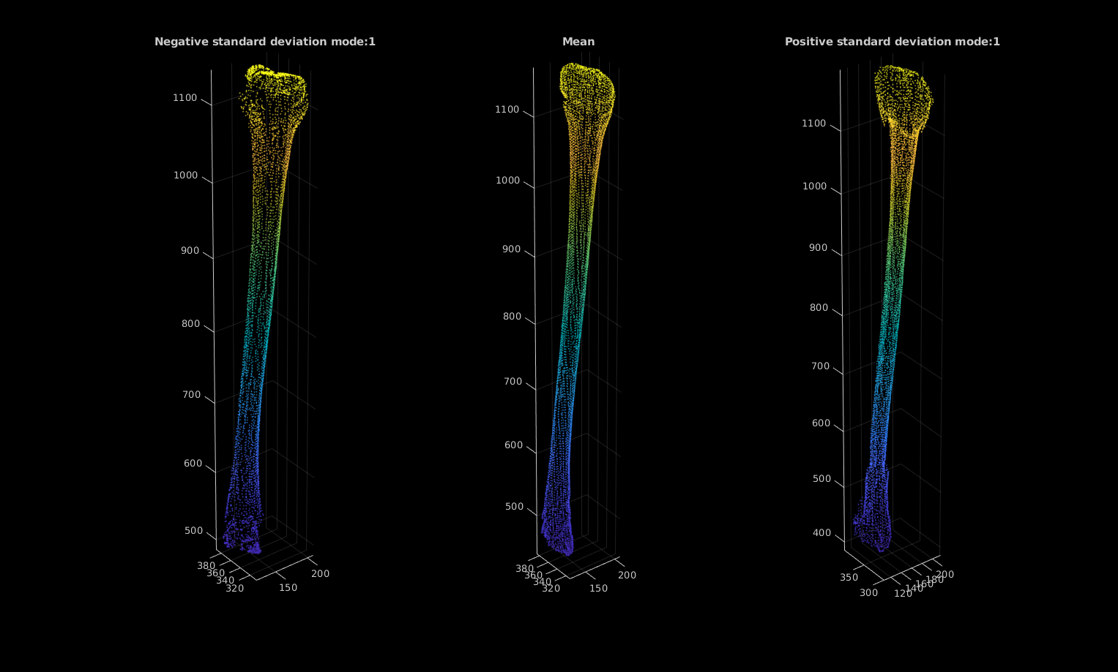

Slide 37
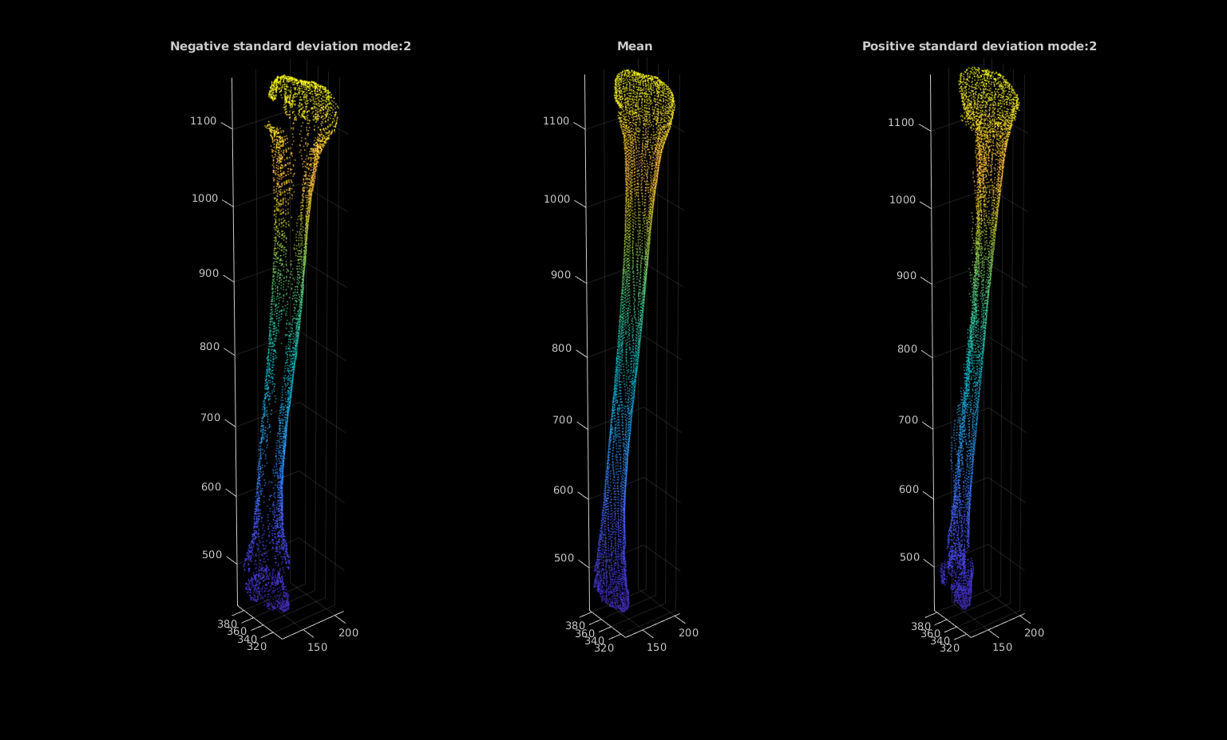

Slide 38
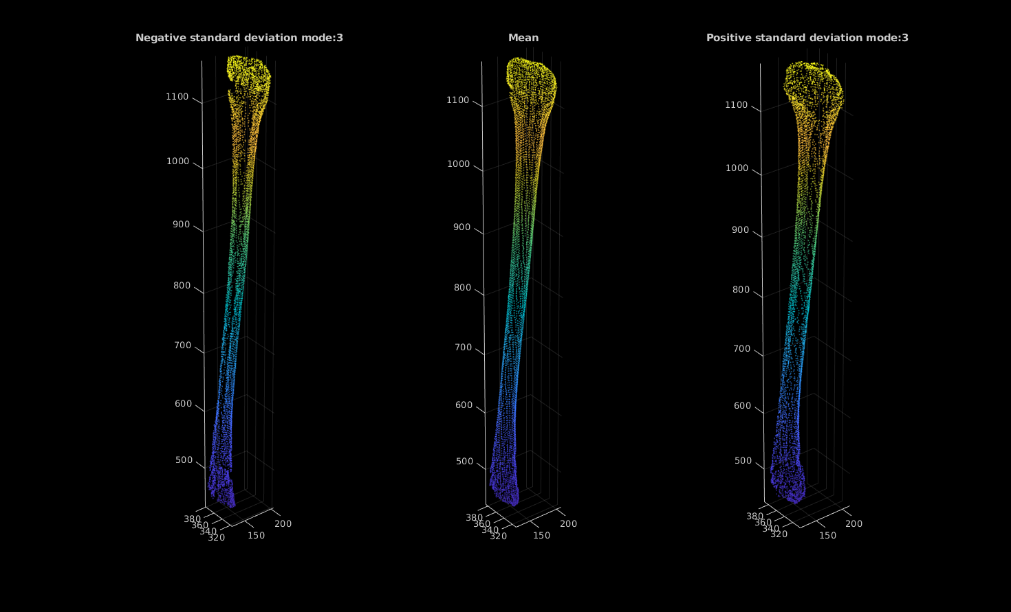

Slide 39
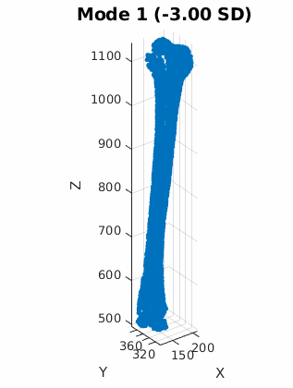
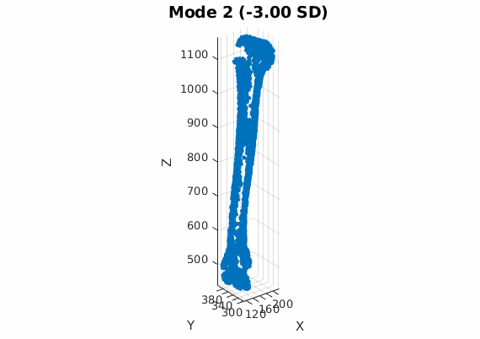
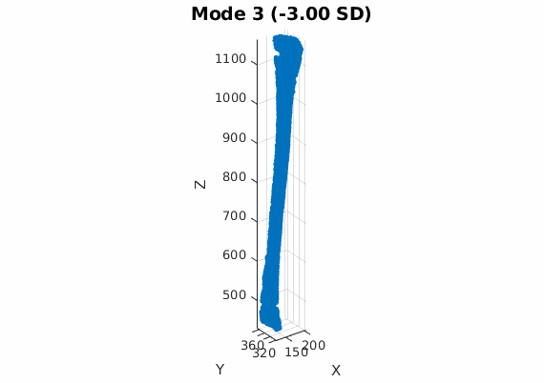

Slide 40
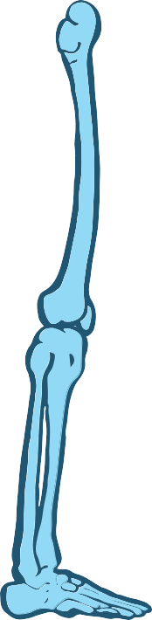
The explained variance indicates that the first three modes capture only around 80% of the dataset variance, which suggests that the model does not fully represent the shape variability. Observing the point distribution and the newly generated models, we notice several issues: there are many empty spots, and the shape of the tibial peak is not well preserved.
For future work, several improvements could be considered:
Preprocessing the masks to smooth surfaces, e.g., using Laplacian or Gaussian filters.
Incorporating more data to improve correspondence and reduce artifacts.
Exploring alternative dimensionality reduction methods such as Singular Value Decomposition (SVD).
Testing different ways to flatten or reconstruct the point matrices to maintain geometric fidelity.
Using post-processing techniques to fill gaps in the point cloud or improve mesh quality.
Evaluating the use of non-linear PCA or manifold learning to better capture complex variations.

Slide 41
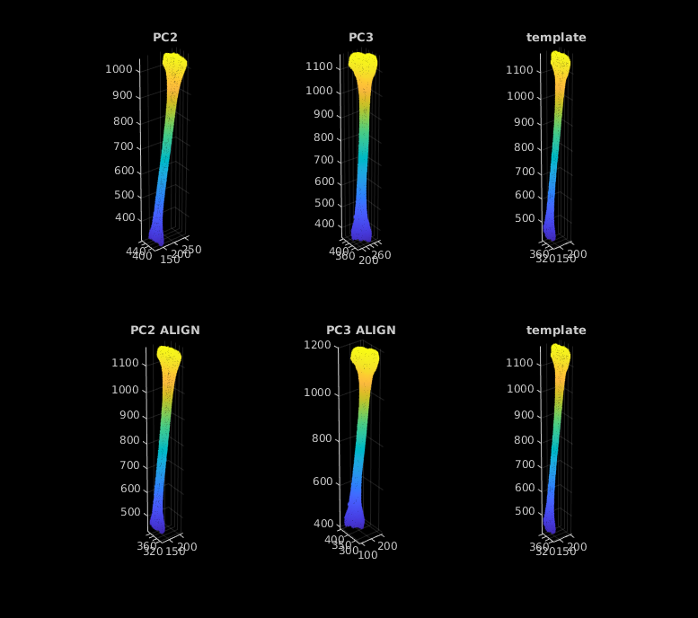
Results
- Built partial 2D–3D registration pipeline.
- Automated segmentation & cleaning process.
- Developed custom SSM pipeline from scratch.
- Produced DRRs quickly and accurately.
Future Work
- Integrate SSM into reconstruction & registration.
- Improve computational efficiency & memory usage.
- Explore deep learning approaches for DRR-to-XR alignment.

Slide 42
Thank you
Do you have any questions?
sofialh40@gmail.com

